Slide 1


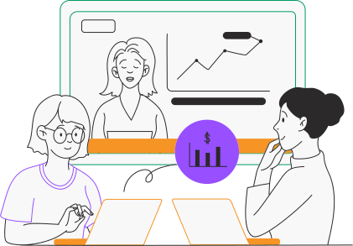

Customer segmentation
analysis (2017)
Done by:
Ali Jafar
Mona Mohd
Rabab Ali
Hasan Ali

Slide 2
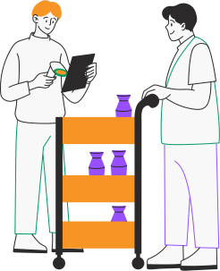
Objective
Goal: To better understand Olist's customers.
Key Objectives:
Find out when customers are making purchases.
Identify which product categories they are buying the most.
Determine which region has the highest number of orders.
Overall Purpose: To provide comprehensive insights that will improve the company's strategy and meet customer needs.

Slide 3
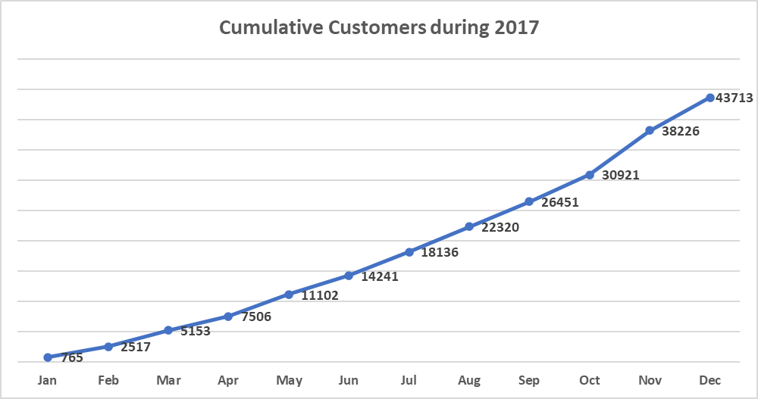
Customers Growth
43713 unique Customers
43713 unique Customers

Slide 4
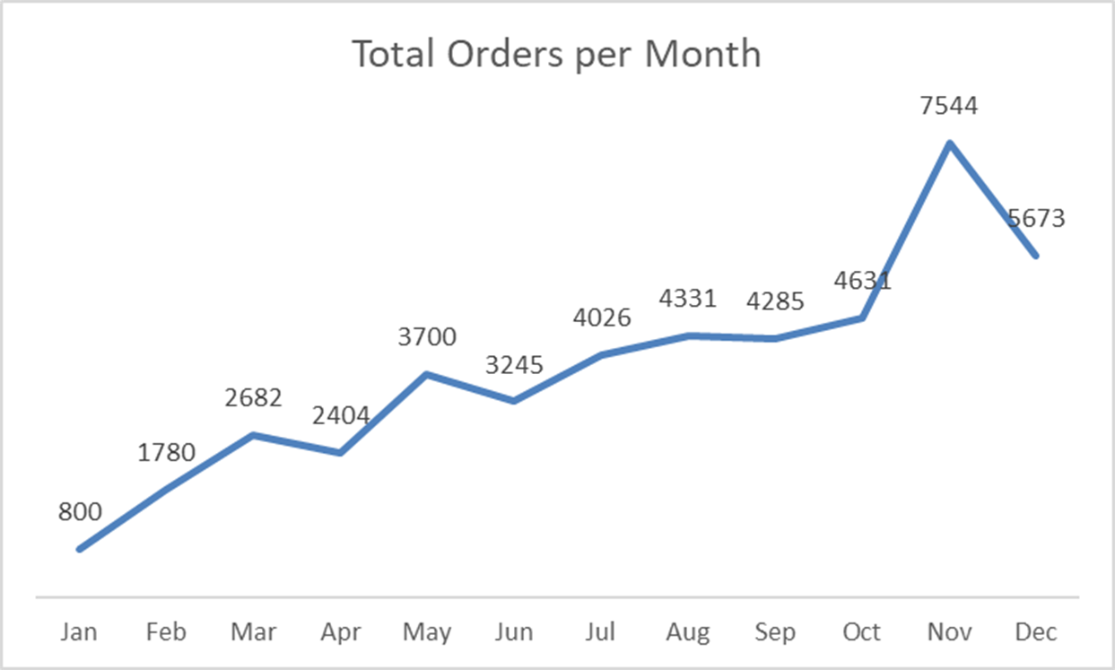
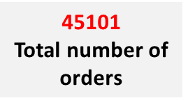
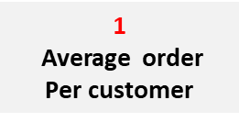
Customer Ordering Trends by Month
May -Mother's Day week
Jun-Valentine's week
Aug-Father's week
Oct-Child's Day week
Nov-Black Friday week

Slide 5
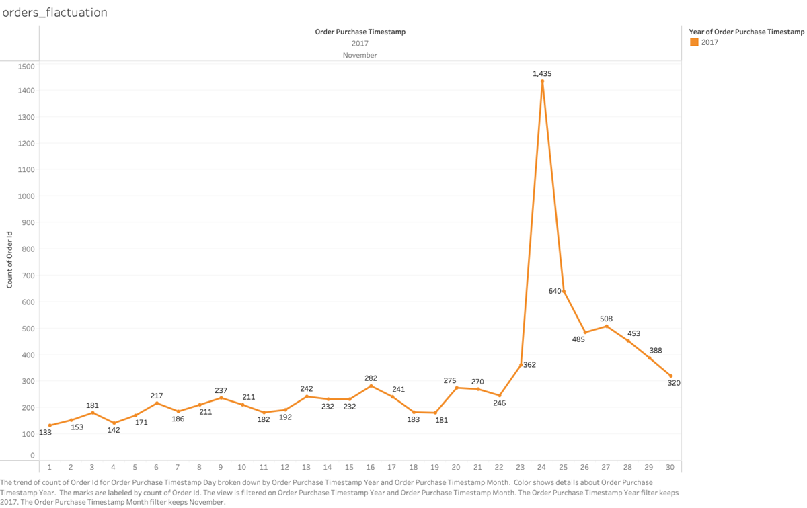
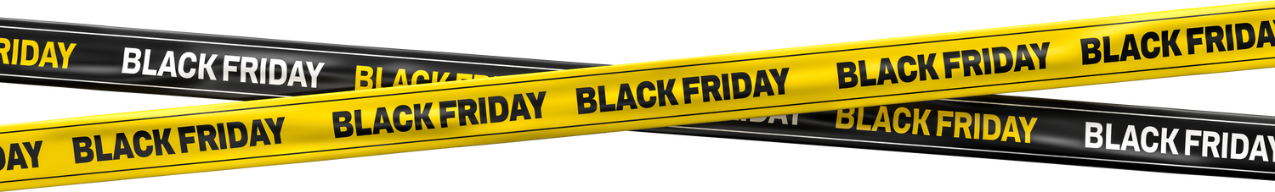
Detailed Orders Analysis – November
Number of orders increased on
black Friday

Slide 6
Discounted orders & Vouchers
1925
Total vouchers used in 2017
756
Orders paid fully with vouchers
5106
Total discounted orders 2017

Slide 7
Geographic segmentation
Southeast
the Highest
North The lowest

Slide 8
Geographic segmentation
Southeast
Most Orders
North Least orders

Slide 9
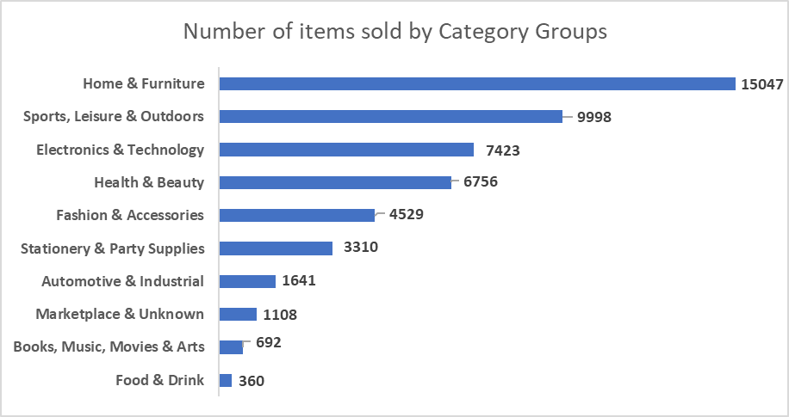
Customer Category group Preferences

Slide 10
649
Repeated Customers Preferences
1925
The total number of repeated customers
649
Customers
purchased from different Category Groups

Slide 11
Behavioral segmentation – Purchase
Most customers bought only one product type during the year, and most orders contained just a single item.

Slide 12
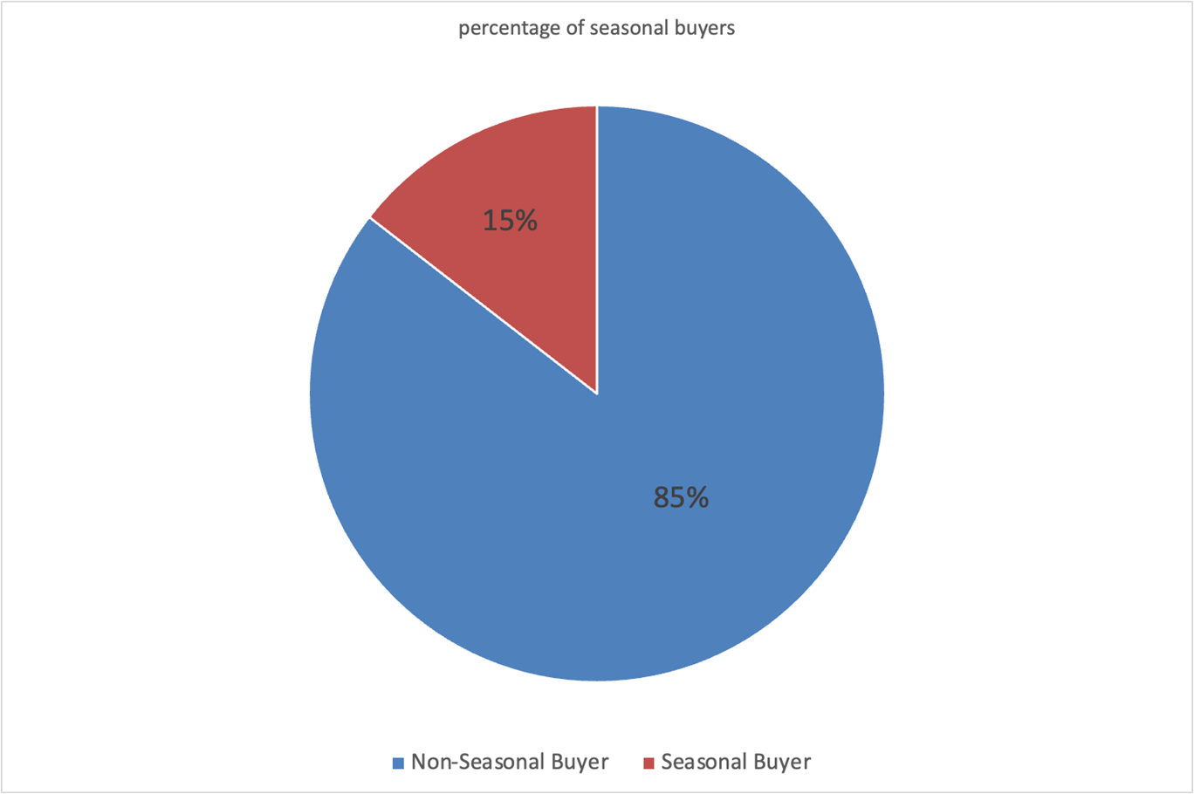
Behavioral segmentation – Purchase
15 %
of customer purchasing only on Weekends

Slide 13
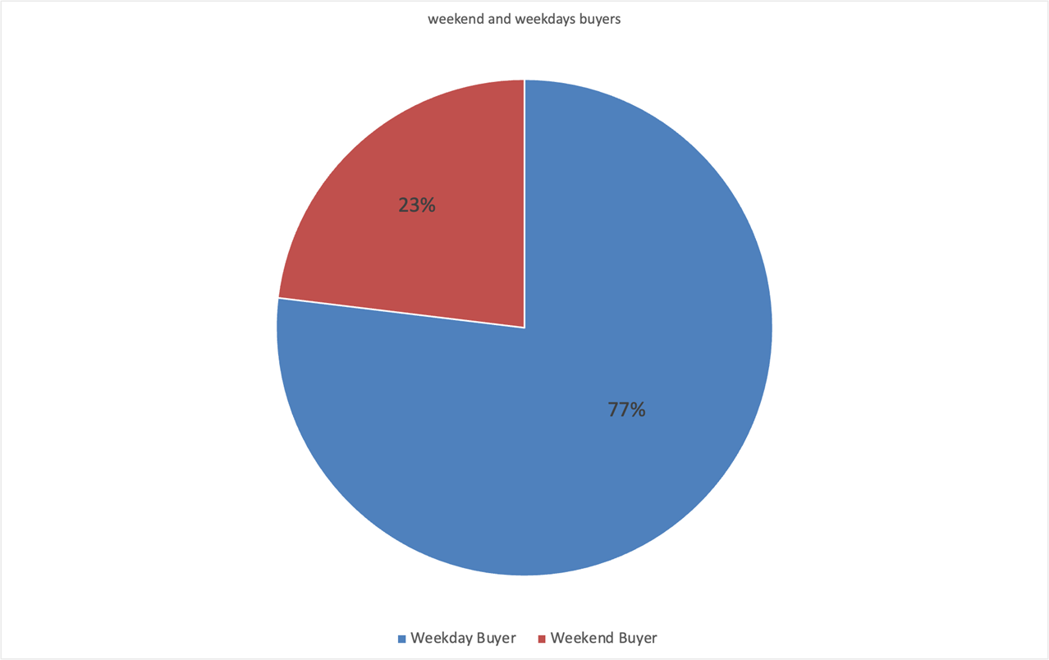
Weekend buyers
23 %
of customer purchasing only on Seasons weeks

Slide 14
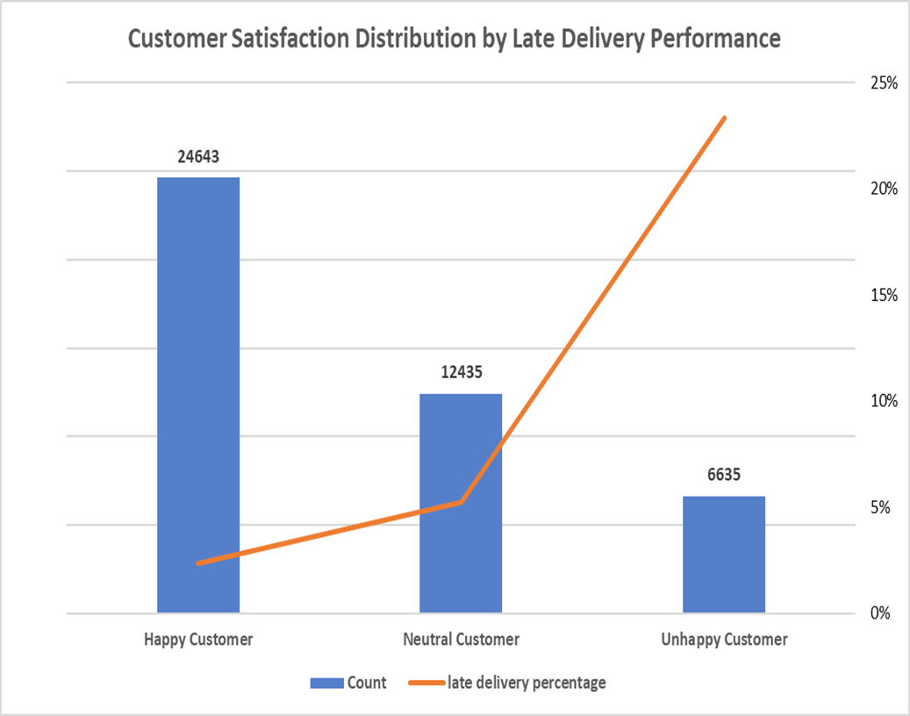

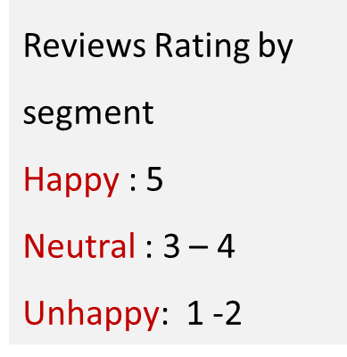
Behavioral segmentation – Satisfaction

Slide 15
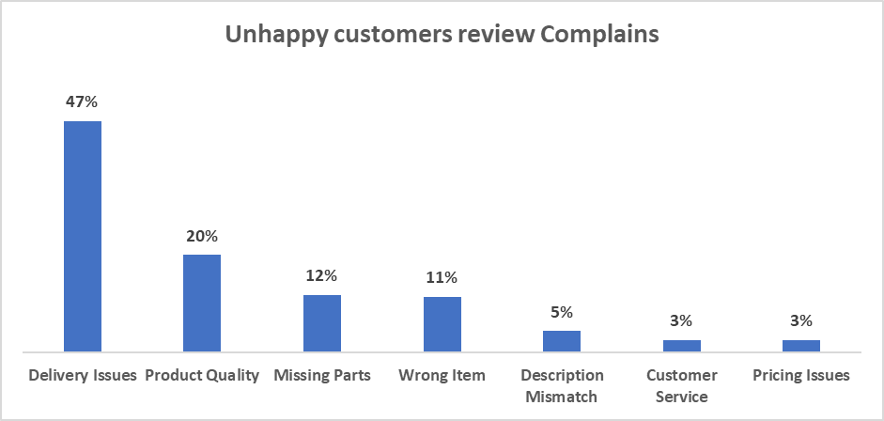
Behavioral segmentation – Satisfaction

Slide 16
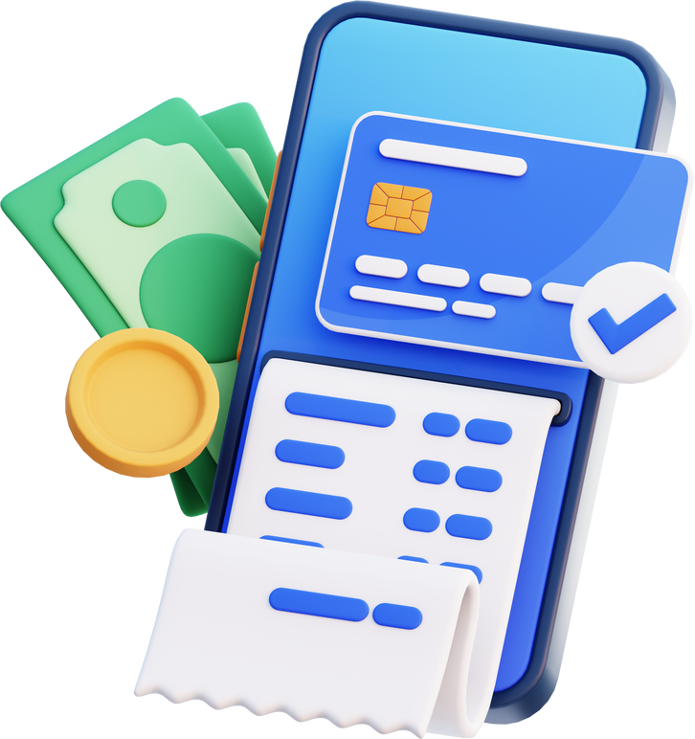
Payment method
3027 Transactions Through
vouchers
Vouchers considered as a discount mechanism

Slide 17
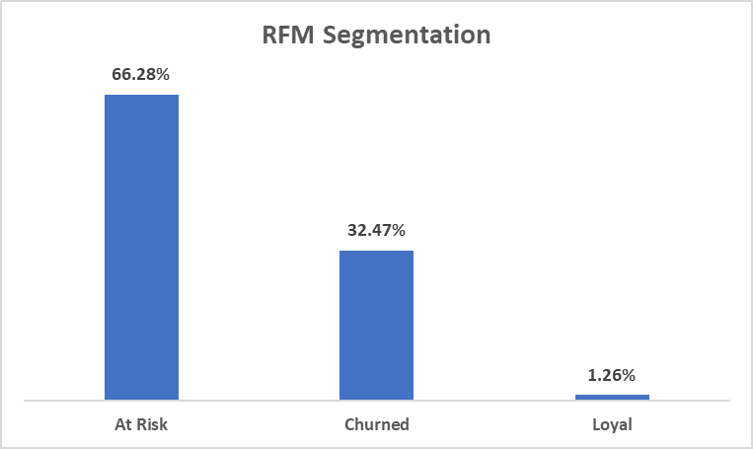
RFM & CLV
Based on Frequency & Recency
CLV
Median LTV : R$ 37.18
Top 10% LTV: R$ 111.73
Avg Lifetime (days): 2.3

Slide 18

Recommendtion
Set a strict on-time delivery and track it weekly; add proactive delay notifications.
marketing recommendations: try to put some discounts on the seasonal events to attract more customers
give some vouchers to those who got a late delivery orders or the unsatisfied customers

Slide 19
Conclusion
In the 2017 data, most shoppers are one-time purchasers, so we can’t reliably define a loyal-customer segment at this stage.
Strengthening post-purchase experience (delivery + accuracy + quality) is likely to lift satisfaction first—and only then reveal repeat-purchase behavior we can measure as “loyalty.”

Slide 20


